Slide 1
Count of GrLivArea vs Sale
File created on: 11/6/21 10:43:18 PM EDT

Slide 2
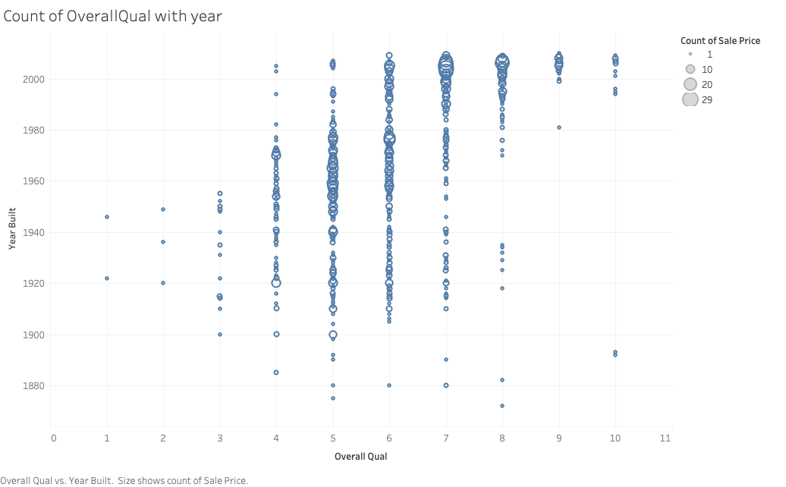

Slide 3
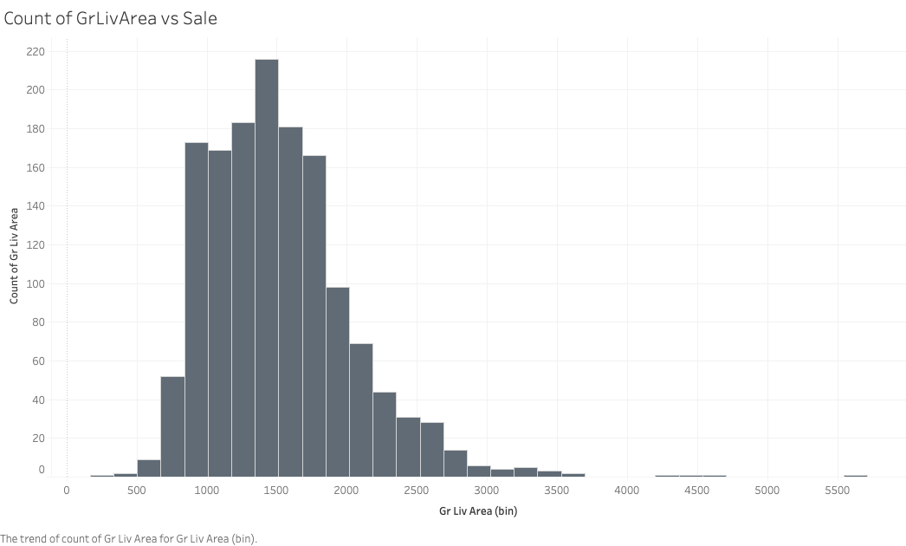

Slide 4
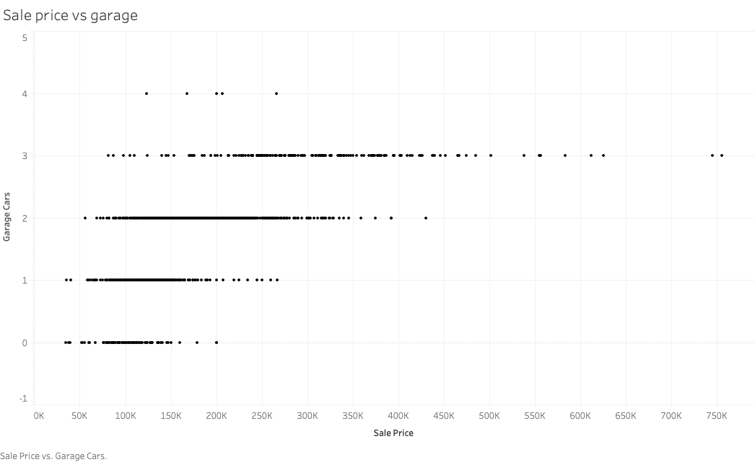

Slide 5
